Slide 1
Permutations, Combinations, and Zombies
Halloween Edition
Aubrey Smiley McAuliffe and Matt Sparr

Slide 2
A quick note about probability:
You may see the occasional question about the probability of “at most” x events occuring.
At Most 3 cases of Ebola includes the probabilities of 0, 1, 2, and 3 cases

Slide 3
Counting Methods
We need to get to Toronto. It’s urgent
On the first leg, we need to get to Philadelphia.
We can get there by train, personal vehicle, or Greyhound Bus
On the second leg, we go from Philly to Toronto.
From here, we can either hitchhike or take a plane.
How many different ways can we get there?
{(Train, Hitchhike), (POV, Hitchhike), (Greyhound, Hitchhike), (Train, Plane), (POV, Plane), (Greyhound, Plane)}
If m is the number of options in step 1 and n is the number of options in step 2, total options= m*n

Slide 4
Enter the Factorial
We have 11 stuffed animals. Why? Because.
How many ways can we line them up?
11*10*9*8*7*6*5*4*3*2*1 = 39916800
We can write this as 11!
Notice that we didn’t use any animal more than once.

Slide 5
Creepy Counting Practice Problems
At Crispy, the local custom chocolate shop, there are three types of chocolate, four blood types for filling, and seven options for dried insect toppings. How many options do you have to choose from?
A serial killer is on the loose. An eye witness caught a glimpse of the license plate and noticed that it’s a Tennessee plate and the first two figures were “UZ”. If a license plate is made of of three letters, followed by four numbers, how many possible license plates are there for the serial killer’s car?

Slide 6

Permutations
How many ways are there to combine objects if order matters?
If you can repeatedly select an object (with replacement), it’s just , , where n is the number of objects and r is the number of slots to fill.
If you can’t reuse objects (without replacement), you use the same method as in our counting techniques: n!
What if you don’t want to arrange the objects until you run out?
(n!)/(n-r)! Where r is the number of objects you want to select.

Slide 7
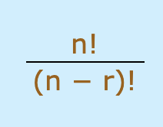
Example
Svetlana, local cultural leader wants to put on an undead rendition of The Book of Mormon. Seven actors will play all of the characters (as they do on Broadway). However, 120 zombies roll up for the audition. How many ways could Svetlana cast the play?
120!/(120-7)!
There are 2.9981735e+14 ways to cast characters

Slide 8
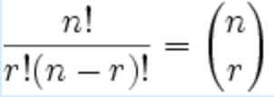
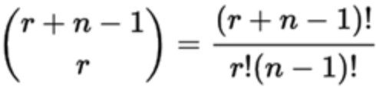
Combinations
What if order doesn’t matter?
If repetitions are not allowed:
If repetitions are allowed:

Slide 9
Examples
Let’s return to Crispy. It turns out, they also make petit fours with different types of filling and frosting (eye goo, blood, spiders, bile, rodent pate, etc). If Crispy offers 8 different varieties of petit fours and we want a box of 12 (obviously, with repeats allowed), how many different boxes could we make?
Here, r = 12 and n = 8. (12+8-1) choose (12) = C(19, 12) = 50388 different boxes
Atlanta has been hit by a zombie outbreak and wants to build a new hockey team. The city has 36 zombies currently and is holding tryouts for the pool of 20 players. No zombie can be used twice, but they don’t know which positions they’ll fill yet.
This is a combination without repetition: n = 36 and r = 20, C(56, 20) = 7307872110

Slide 10
Python Combination Examples with Matt

Slide 11
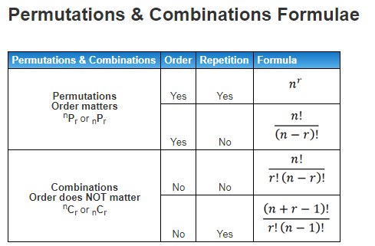
Practice Problems
Out of the 20 zombies on the team, how many different teams of 6 could be on the ice for a period?
The cast of Zombie Book of Mormon is doing community outreach and needs a team of two to answer public questions. How many teams of two could there be?
3. A scientist is making a homunculus out of organs she bought on the black
market. She needs 1 brain, 2 lungs, 2 kidneys, 1 liver, and 1 heart. (The
homunculus does not eat or drink.) Being a cautious scientist, she bought five of every type of organ. How many different types of Homunculus could she make?

Slide 12
Do we have time?
Gambling- let’s play poker.

Slide 13

What’s the probability of getting Four of a Kind?
First, how many different 5-card hands are there?
C(52, 5) = 1,598,9604
We’ll use this as our denominator for all poker hand probabilities
This hand consists of on value out of 13, but in all four suits. Then, it has another card and it doesn’t matter what that card is.
Choose the value: C(13, 1) and then choose all four suits: C(4, 4). Lastly, choose a value for the fifth card and a suit for that value: C(12, 1) and C(4,1).
Multiply all of our choices across the numerator:
This comes out to 624
624/1,598,9604 = 0.00003902535

Slide 14
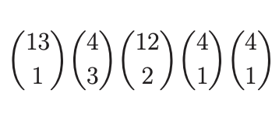
What’s the probability of Three of a Kind?
Choose a value, grab three of the four.
Choose two other values, grab suits for them.
This comes out to 54,912
54,912/1,598,9604 = 0.00343423139

Slide 15
What’s the probability of getting two pairs?
What’s the probability of a Flush? (All the same suit, but no matching values)

